Slide 1

Introduction to Operating Systems CS/COE 1550
Fall 2021
Sherif Khattab
ksm73@pitt.edu
(Some slides are from Silberschatz, Galvin and Gagne ©2013)

Slide 2
Announcements
Upcoming deadlines:
Homework 3: due on 2/12
Tophat questions due one week after each lecture
Project 1: due on 2/19
VS Code
Please exit from Qemu using CTRL+a then x

Slide 3
Last Lecture …
Monitors
Usage
Implementation
Other synchronization mechanisms

Slide 4
Muddiest Points (1/3)
Mesa and Hoare
When are Mesa vs. Hoare semantics used?
Process communication within monitors
The process of cond vars with P and Q and signalling and waiting
Why exactly if vs while determines if the signaling process waits or proceeds
Why Hoare is better than Mesa
Monitors vs semaphores
The usefulness of condvars

Slide 5
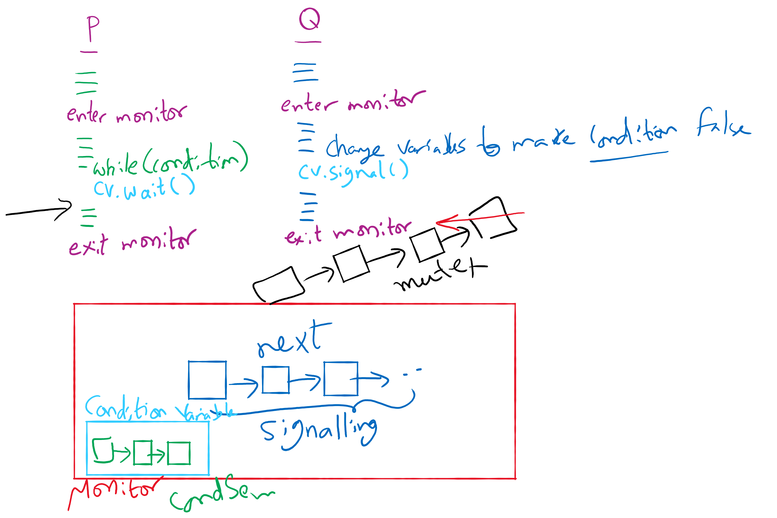
Process Synchronization inside Monitors

Slide 6
Muddiest Points (2/3)
implementing condition variables and the locks
will we ever have to implement a monitor?
How down and up work in the diagram for implementing locks with semaphore
The different queues in the lock diagram
Monitors:
can you have multiple “copies” of a synchronized method or class so that only a max number of processes can run it at a time (specifically in java)
what's the difference between signal() and wakeup(), what is conditionVariable queue, how condition variable works, feel lost in Sahara with both the recording and the picture on the screen
Is it possible for monitors to have multiple condition variables which would allow for more than one process to be inside of a class/monitor at a given time?
What does it mean that signals on condition variables aren't "saved up"?
How processes enter and exit monitors

Slide 7
Muddiest Points (3/3)
Project 1:
How to start this project
How to implement PCB list in the semaphore
Message Passing
How are multiple channels managed in message passing?
What exactly a barrier is and how it relates to message processing
i think i just need a better foundational understanding of what spinlocks/semaphores/monitors are because i'm extremely lost when looking at details

Slide 8
Today’s Agenda …
Classical Process Synchronization Problems
Bounded Buffer
Readers-Writers
Dining Philosophers

Slide 9
Xv6 Walkthrough
sleep and wakeup

Slide 10
Classical synchronization problems
Bounded Buffer
Multiple producers and consumers
Synchronize access to shared buffer
Readers & Writers
Many processes that may read and/or write
Only one writer allowed at any time
Many readers allowed, but not while a process is writing
Dining Philosophers
Resource allocation problem
N processes and limited resources to perform sequence of tasks
Goal 1: use semaphores to implement solutions to these problems
Goal 2: use locks and condition variables to implement solutions to these problems

Slide 11
Bounded buffer problem
Goal: implement producer-consumer without busy waiting

Slide 12
Thread spawning

Slide 13
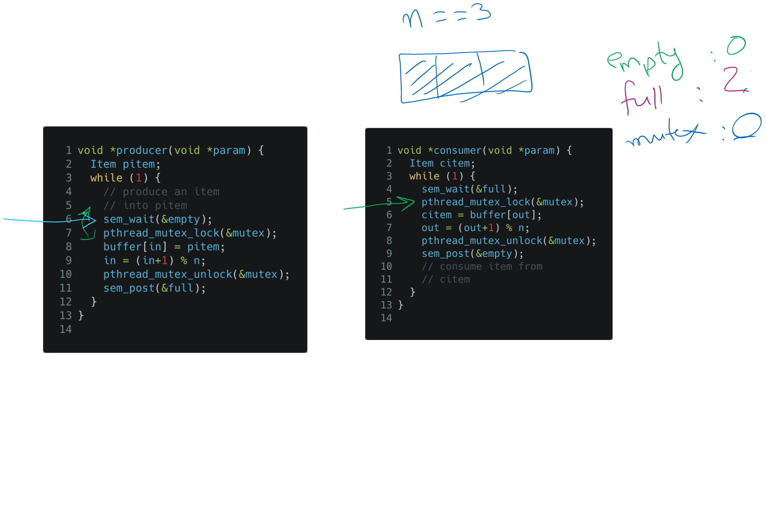
Tracing the solution

Slide 14
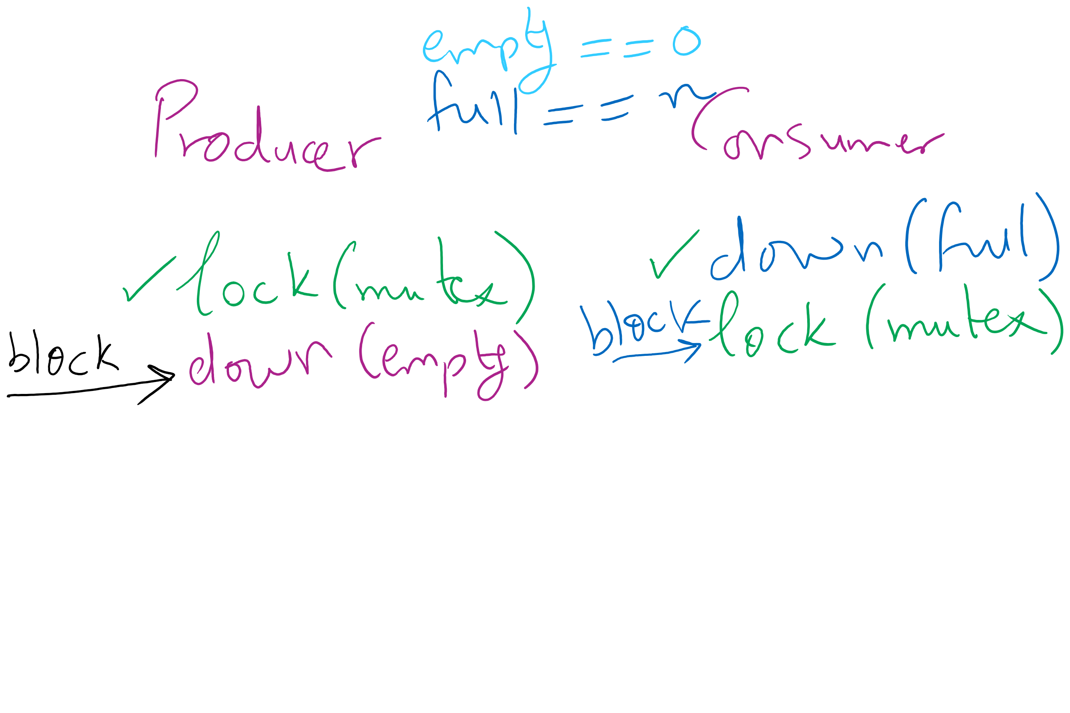
Deadlock can happen with a small mistake

Slide 15
Readers-writers problem
Shared variables
int nreaders;
Semaphore mutex(1), writing(1);
Reader process
…
mutex.down();
nreaders += 1;
if (nreaders == 1) // wait if
writing.down(); // 1st reader
mutex.up();
// Read some stuff
mutex.down();
nreaders -= 1;
if (nreaders == 0) // signal if
writing.up(); // last reader
mutex.up();
…
Writer process
…
writing.down();
// Write some stuff
writing.up();
…

Slide 16
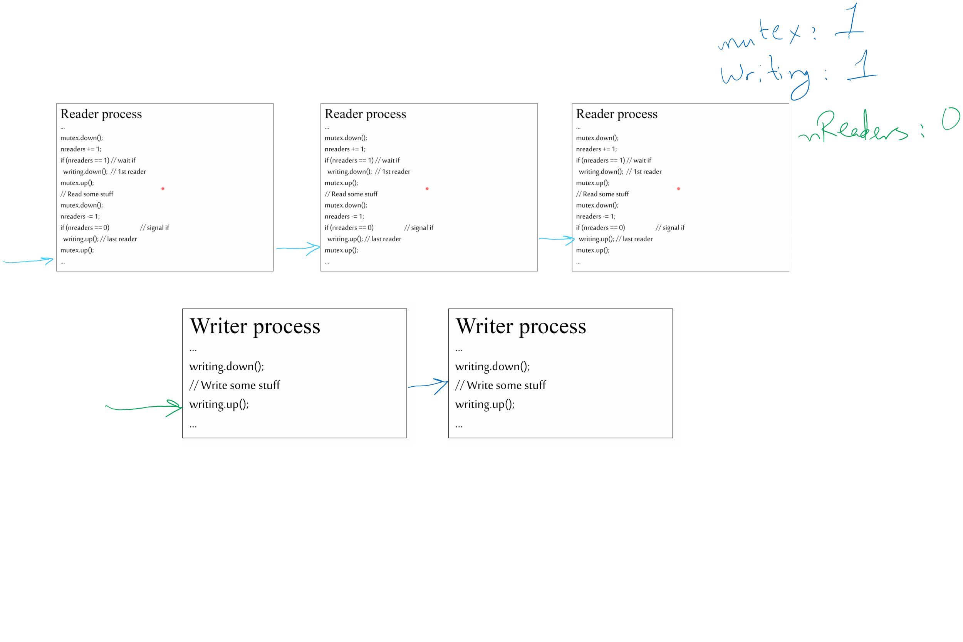
Tracing the solution

Slide 17


Dining Philosophers
N philosophers around a table
All are hungry
All like to think
N chopsticks available
1 between each pair of philosophers
Philosophers need two chopsticks to eat
Philosophers alternate between eating and thinking
Goal: coordinate use of chopsticks

Slide 18
Dining Philosophers: solution 1
Use a semaphore for each chopstick
A hungry philosopher
Gets the chopstick to his right
Gets the chopstick to his left
Eats
Puts down the chopsticks
Potential problems?
Deadlock
Fairness
Shared variables
const int n;
// initialize to 1
Semaphore chopstick[n];
Code for philosopher i
while(1) {
chopstick[i].down();
chopstick[(i+1)%n].down();
// eat
chopstick[i].up();
chopstick[(i+1)%n].up();
// think
}

